Slide 1



Hospital Resource & Patient Management System
with Emergency Bed Allocation
Name | Register Number
Mohammed Farmanullah R | 1972260040
B. Balasuriya | 1911260010
Bala Ashwin R | 1921260102
Object Oriented Programming in C++
Faculty: Dr. Parimala Kanaga Devan .K · Slot: D

Slide 2

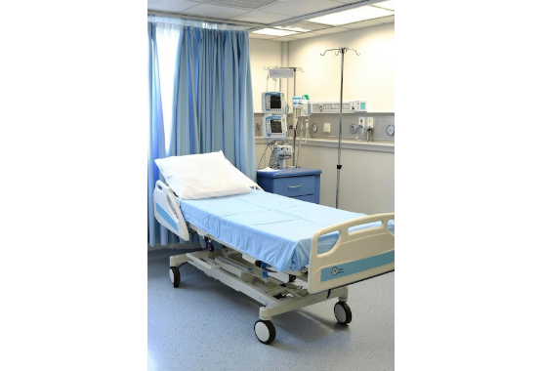
Introduction
•
Hospital resource management is absolutely essential for delivering efficient and timely patient care.
•
Unexpected bed shortages can cause severe delays, particularly during critical emergencies.
•
Manual tracking methods may frequently result in resource mismatch and significantly longer waiting times.
•
The proposed system provides an automated, real-time bed and patient management solution built in C++.

Slide 3
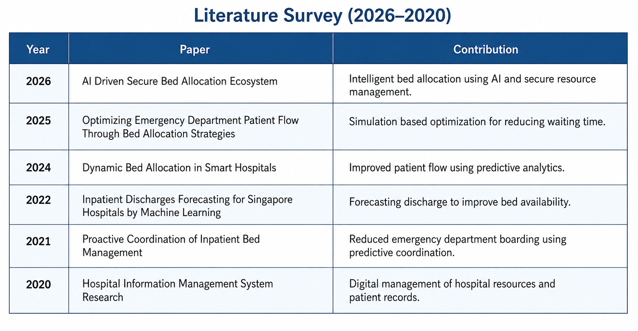

Slide 4






Problem Statement
Manual Constraints
Emergency Delays
Inefficiency
Manual tracking of bed availability creates bottlenecks. It leads to difficulty in maintaining accurate and updated patient records across wards.
Dangerous delays in emergency bed allocation occur frequently due to poor coordination between varying hospital departments.
Consistent resource mismatch causes inefficient utilization of hospital facilities and significantly increases overall patient waiting times.

Slide 5
Project Objectives
Automate Tracking: Provide real-time bed availability tracking to eliminate guesswork and manual checks.
Emergency Allocation: Instantly allocate emergency beds based on assessed patient priority and severity.
Secure Records: Maintain robust and secure patient records using structured digital storage.
Reduce Waiting: Minimize patient waiting time and significantly reduce resource misallocation.
Live Updates: Provide administrative and medical staff with real-time resource status updates continuously.

Slide 6

Existing System
Manual Bottlenecks
The current system relies heavily on manual bed monitoring and static resource information. This disjointed approach directly leads to delayed emergency allocation and a higher possibility of critical human errors.
Manual patient registration drastically restricts tracking capabilities and lowers efficiency.

Slide 7

Proposed System
•
A comprehensive, C++-based Hospital Resource and Patient Management System.
•
Real-Time Tracking: Instant bed availability updates across all hospital wings.
•
Smart Triage: Priority-based emergency bed allocation logic ensures the most critical patients are served first.
•
Digital Workflows: Automated patient registration paired with highly secure record management.
•
OOP Efficiency: Optimized resource allocation utilizing advanced C++ data structures.

Slide 8


System Modules
Patient Core Functions
Resource Core Functions
•
Patient Management: Registration and detail updates.
•
Bed Management: Real-time occupancy tracking.
•
Resource Allocation: Matching patients to beds.
•
Emergency Management: Priority triage and assessment.
•
Admin & Reports: System overview and status exports.
•
Record Management: Secure data storage and retrieval.

Slide 9
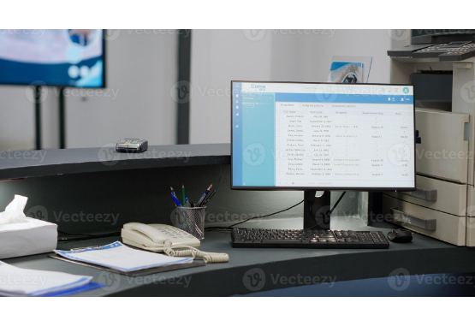
Mod 1: Patient Management
•
Digital Registration: Swiftly register new patients into the centralized hospital database.
•
Data Integrity: Store comprehensive patient details and medical history accurately.
•
Dynamic Updates: Easily update patient information as their condition or treatment progresses.
•
Record Control: Manage holistic patient records seamlessly from a single terminal.
•
Error Reduction: Drastically reduce manual registration errors and duplicated files.
Notes:
PATIENT MANAGEMENT
BED MANAGEMENT
RESOURCE ALLOCATION
PATIENT RECORDS
ADMIN & REPORTS

Slide 10
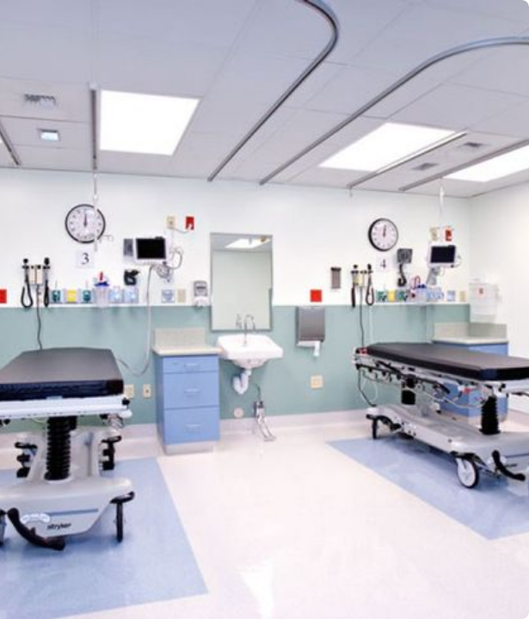
Mod 2: Emergency Priority
Automated Triage
The system actively assesses emergency patient severity and assigns logical priority scores. Critical patients automatically receive higher priority, guaranteeing much faster emergency bed allocation.
This critical module manages incoming patients smoothly using robust priority-based logic.

Slide 11


Mod 3: Bed Management
Real-Time Tracking
This essential module maintains comprehensive bed information across all wards. It actively tracks both available and occupied beds, updating the system status in real-time. By displaying live bed availability dashboards, staff can instantly identify and reserve suitable beds for incoming patients.

Slide 12



Mod 4: Resource Allocation
Intelligent Matching
Priority Logic
Optimization
Automatically match specific patient medical requirements with the appropriate, currently available hospital resources.
Allocate critical beds and resources strictly based on system-assigned priority, significantly reducing resource mismatch.
Vastly improve the overall utilization of hospital beds and provide essential support for faster emergency response times.

Slide 13

Mod 5: Patient Records
•
Secure Storage: Store all sensitive patient information securely within the local system.
•
Easy Modification: Update patient records quickly without risking data corruption.
•
Instant Access: Retrieve historical records instantaneously when required by doctors.
•
C++ Integration: Utilizes advanced C++ file handling mechanisms for persistent, safe storage.
•
Confidentiality: Architecture designed to strictly protect patient confidentiality.

Slide 14
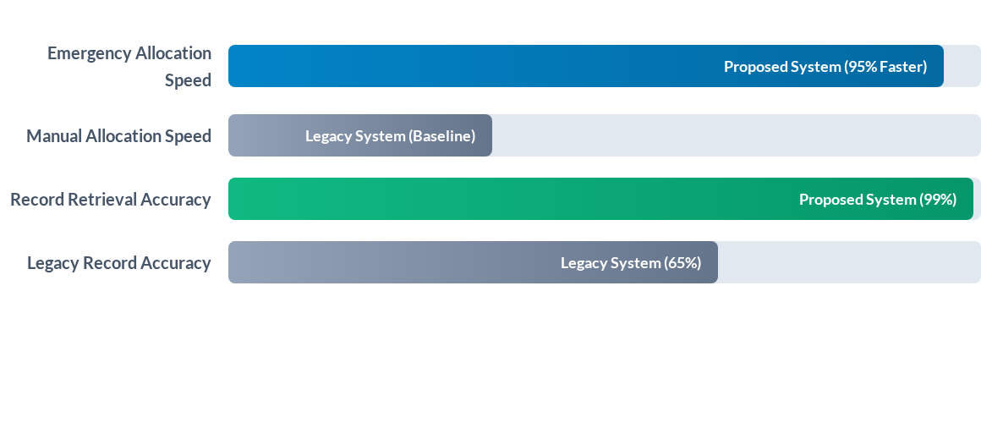
Mod 6: Admin & Reports (Efficiency)
The Admin module empowers staff to view bed availability, monitor records, and generate management reports. As illustrated above, the digital C++ implementation vastly outperforms manual legacy methods in speed and accuracy.

Slide 15
System Use Case
System Actors
Patient, Hospital Staff, Emergency Staff, Administrator.
Main Use Cases
•
Register Patient
•
Check Bed Availability
•
Assess Emergency Priority
•
Allocate Bed
•
Update Bed Status
•
Manage Patient Records & View Reports

Slide 16
System Workflow
2. Triage
4. Finalize
Emergency Priority Calculation.
Update Status & Store Patient Record.
1. Input
3. Allocation
Patient Registration & Initial Assessment.
Check Availability & Allocate Bed.

Slide 17






C++ Concepts Used
Core OOP
Data Structures
Control & Storage
Utilizes fundamental Object-Oriented principles including Classes, Objects, Encapsulation, and Inheritance for modularity.
Implements robust Data Structures: Queues for managing patient waitlists and Arrays for tracking bed statuses efficiently.
Employs precise Conditional Statements for routing logic and C++ File Handling for persistent, secure data storage.

Slide 18
System Advantages
Rapid Action: Faster emergency response times due to automated triage logic.
High Efficiency: Better bed utilization and dramatically reduced patient waiting times.
Total Control: Improved overall resource management for hospital administrators.
Confidentiality: Secure, file-backed patient records protecting sensitive medical data.
Scalability: Cost-effective implementation utilizing a simple and modular C++ architecture.

Slide 19

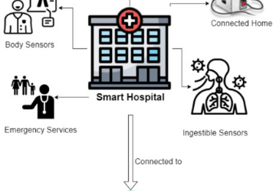


Future Scope & Enhancements
IoT Integration
AI Prediction
Cloud Sync
Future integration with real hospital IoT sensors for automated, live patient monitoring.
Implementing AI-based patient priority prediction to forecast emergency severity proactively.
Transition to cloud-based hospital data management and integration with global electronic health records.

Slide 20
Conclusion
This system significantly improves hospital resource and patient management. By implementing real-time bed tracking and priority-based allocation, it drastically reduces allocation delays and actively supports critical emergency patients. Using C++ and OOP principles provides a highly structured, reliable, and cost-effective foundation that is ready for future expansion.

Slide 21
References
1. Bjarne Stroustrup, The C++ Programming Language, 4th Edition, Addison-Wesley, 2013.
2. Robert Lafore, Object-Oriented Programming in C++, 4th Edition, Sams Publishing, 2002.
3. Herbert Schildt, C++: The Complete Reference, 4th Edition, McGraw-Hill Education, 2014.
4. Ellis Horowitz, Sartaj Sahni and Susan Anderson-Freed, Fundamentals of Data Structures in C++, 2nd Edition, Silicon Press, 2007.
5. ISO — Health informatics standards and resources
6. World Health Organization — Digital health
7. C++ Reference — cppreference.com
8. GeeksforGeeks — C++ and Data Structures

Slide 22
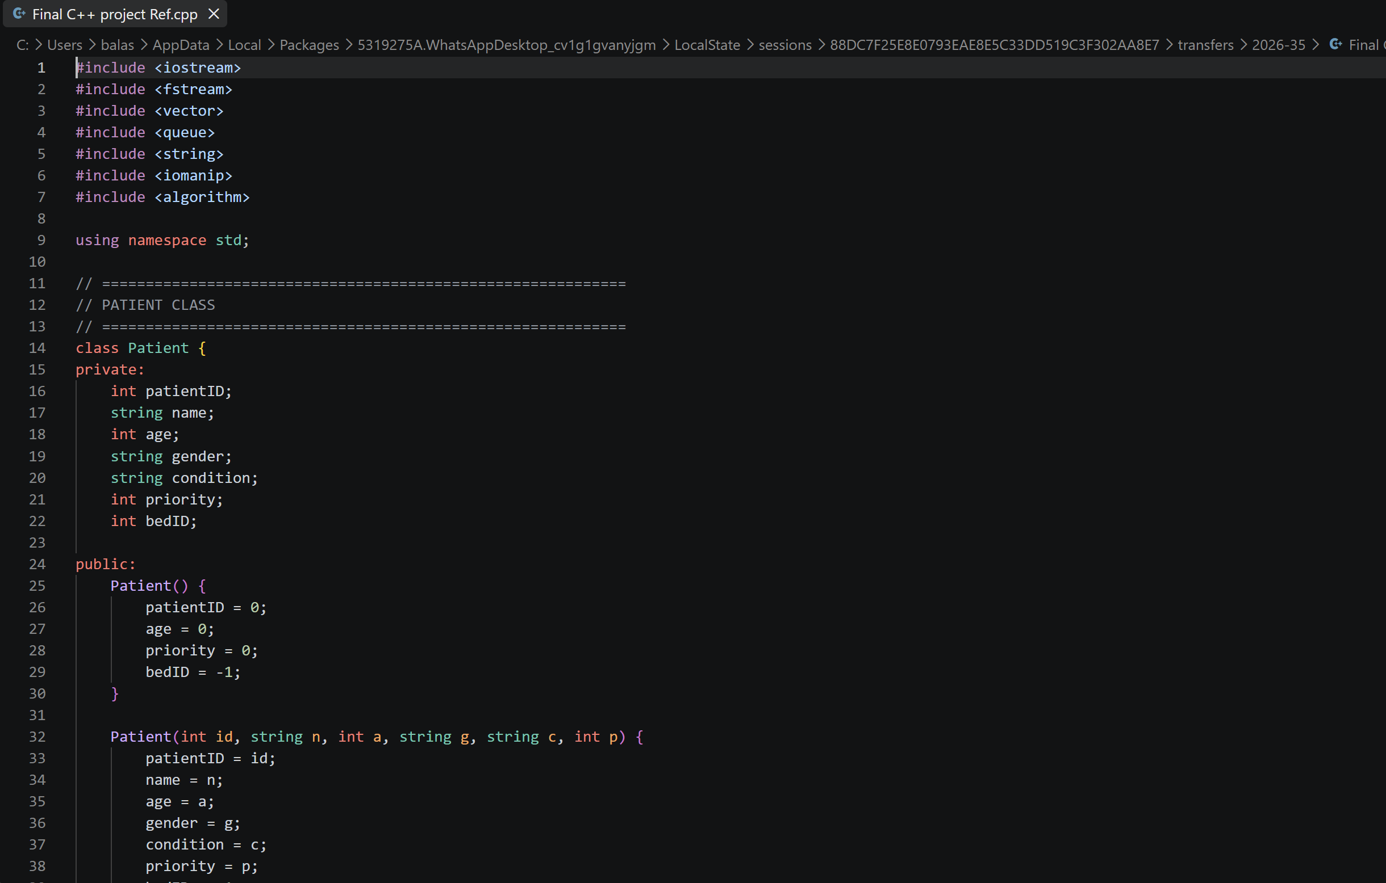

Slide 23
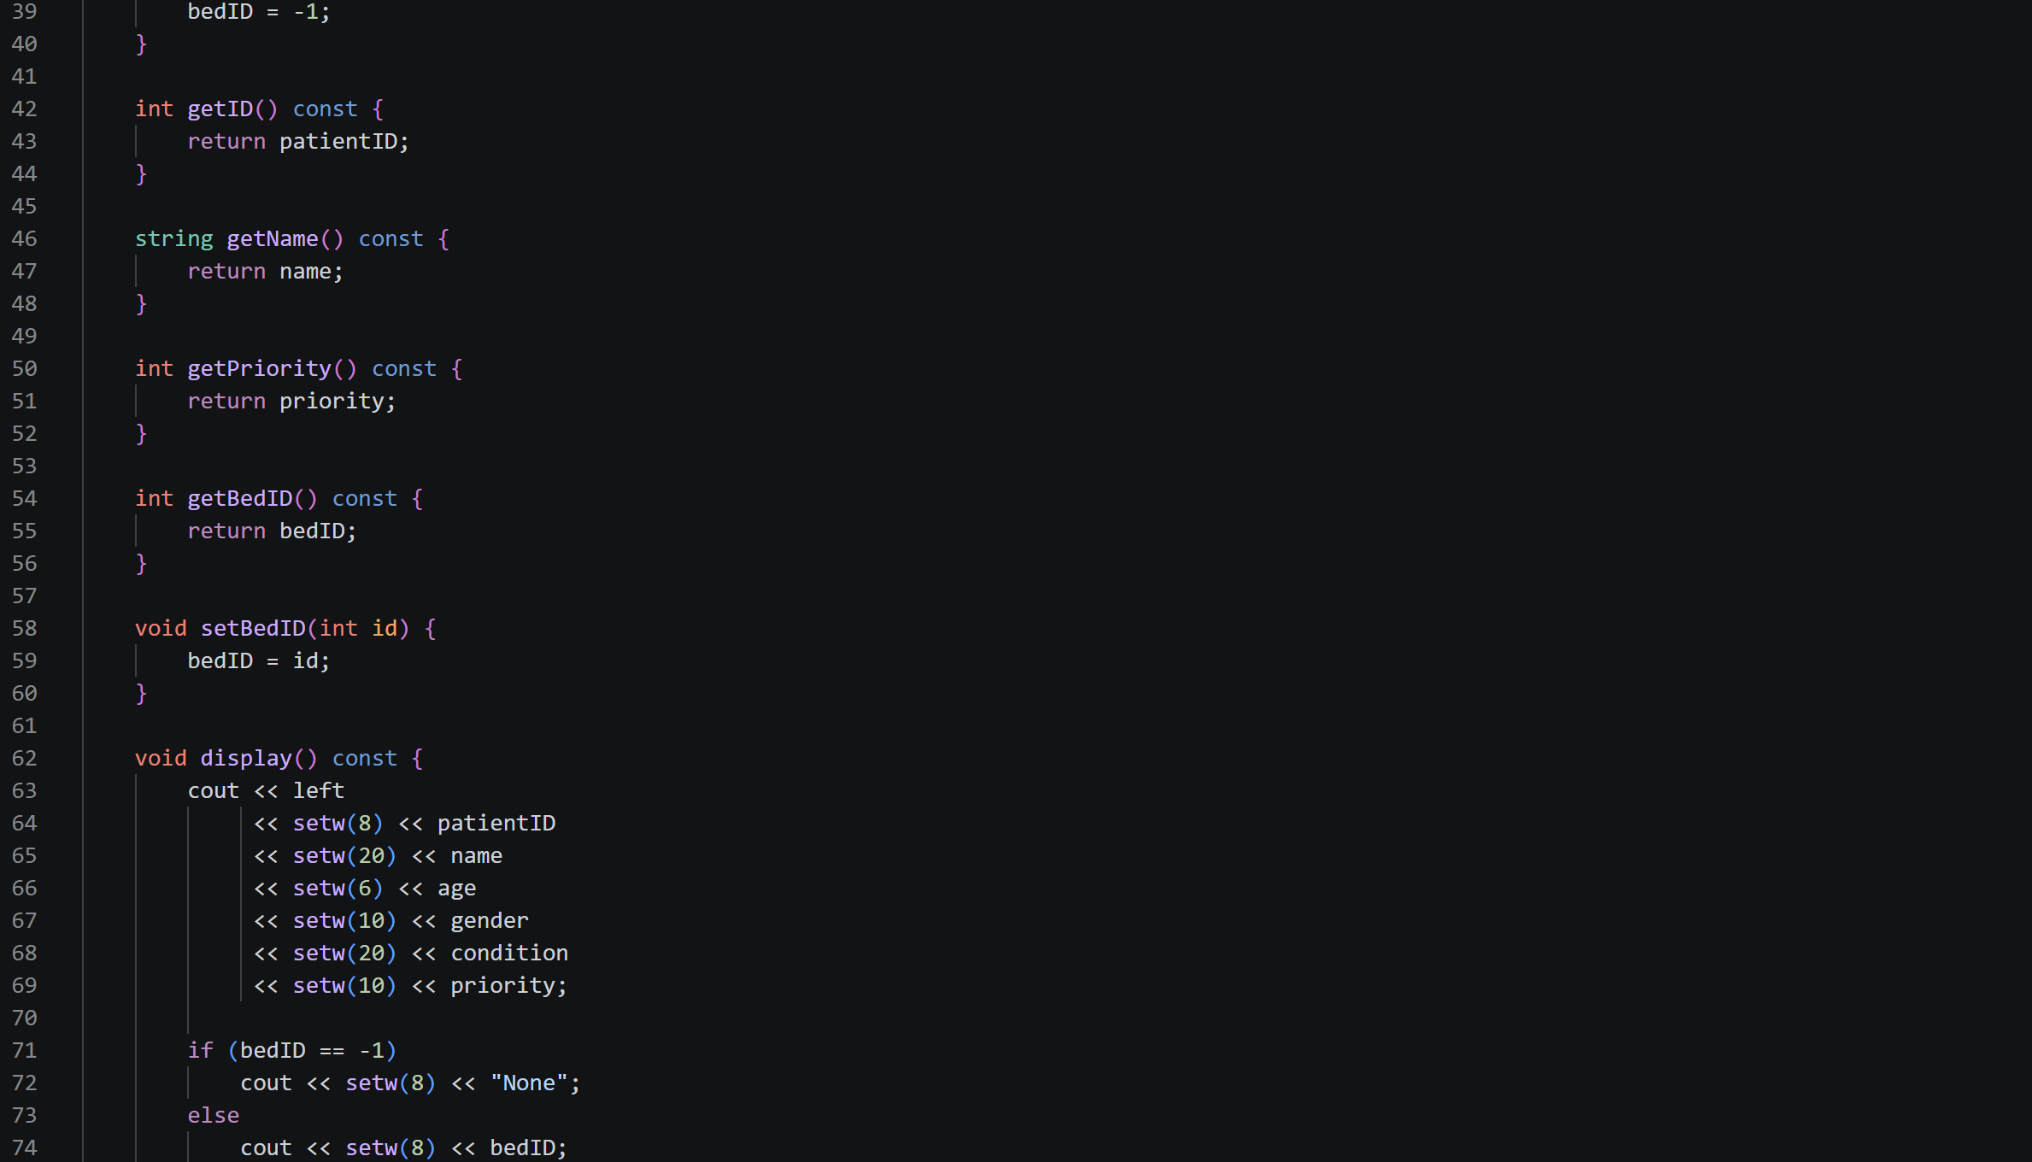

Slide 24
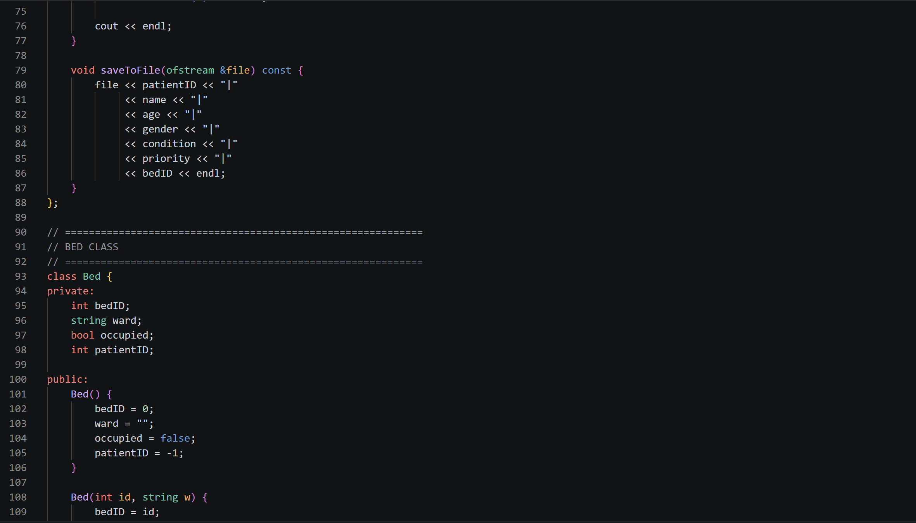

Slide 25
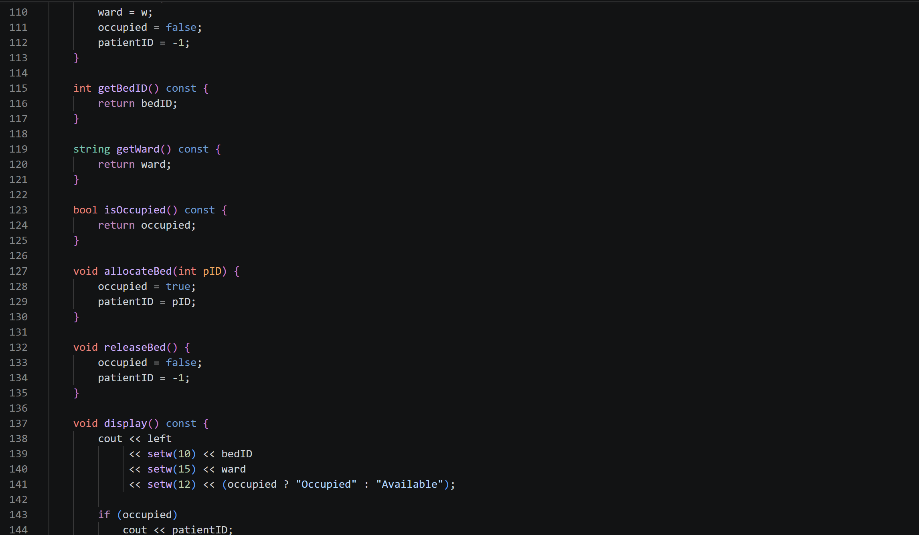

Slide 26
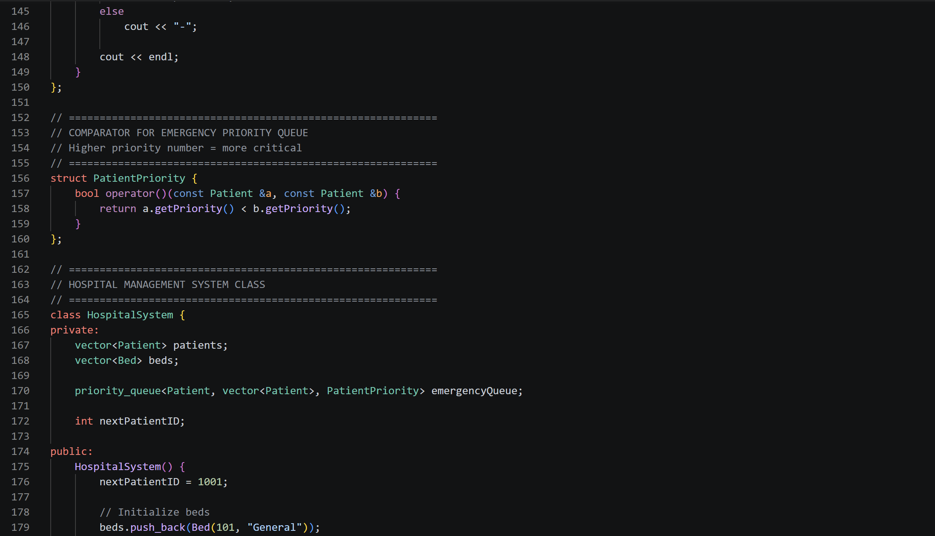

Slide 27
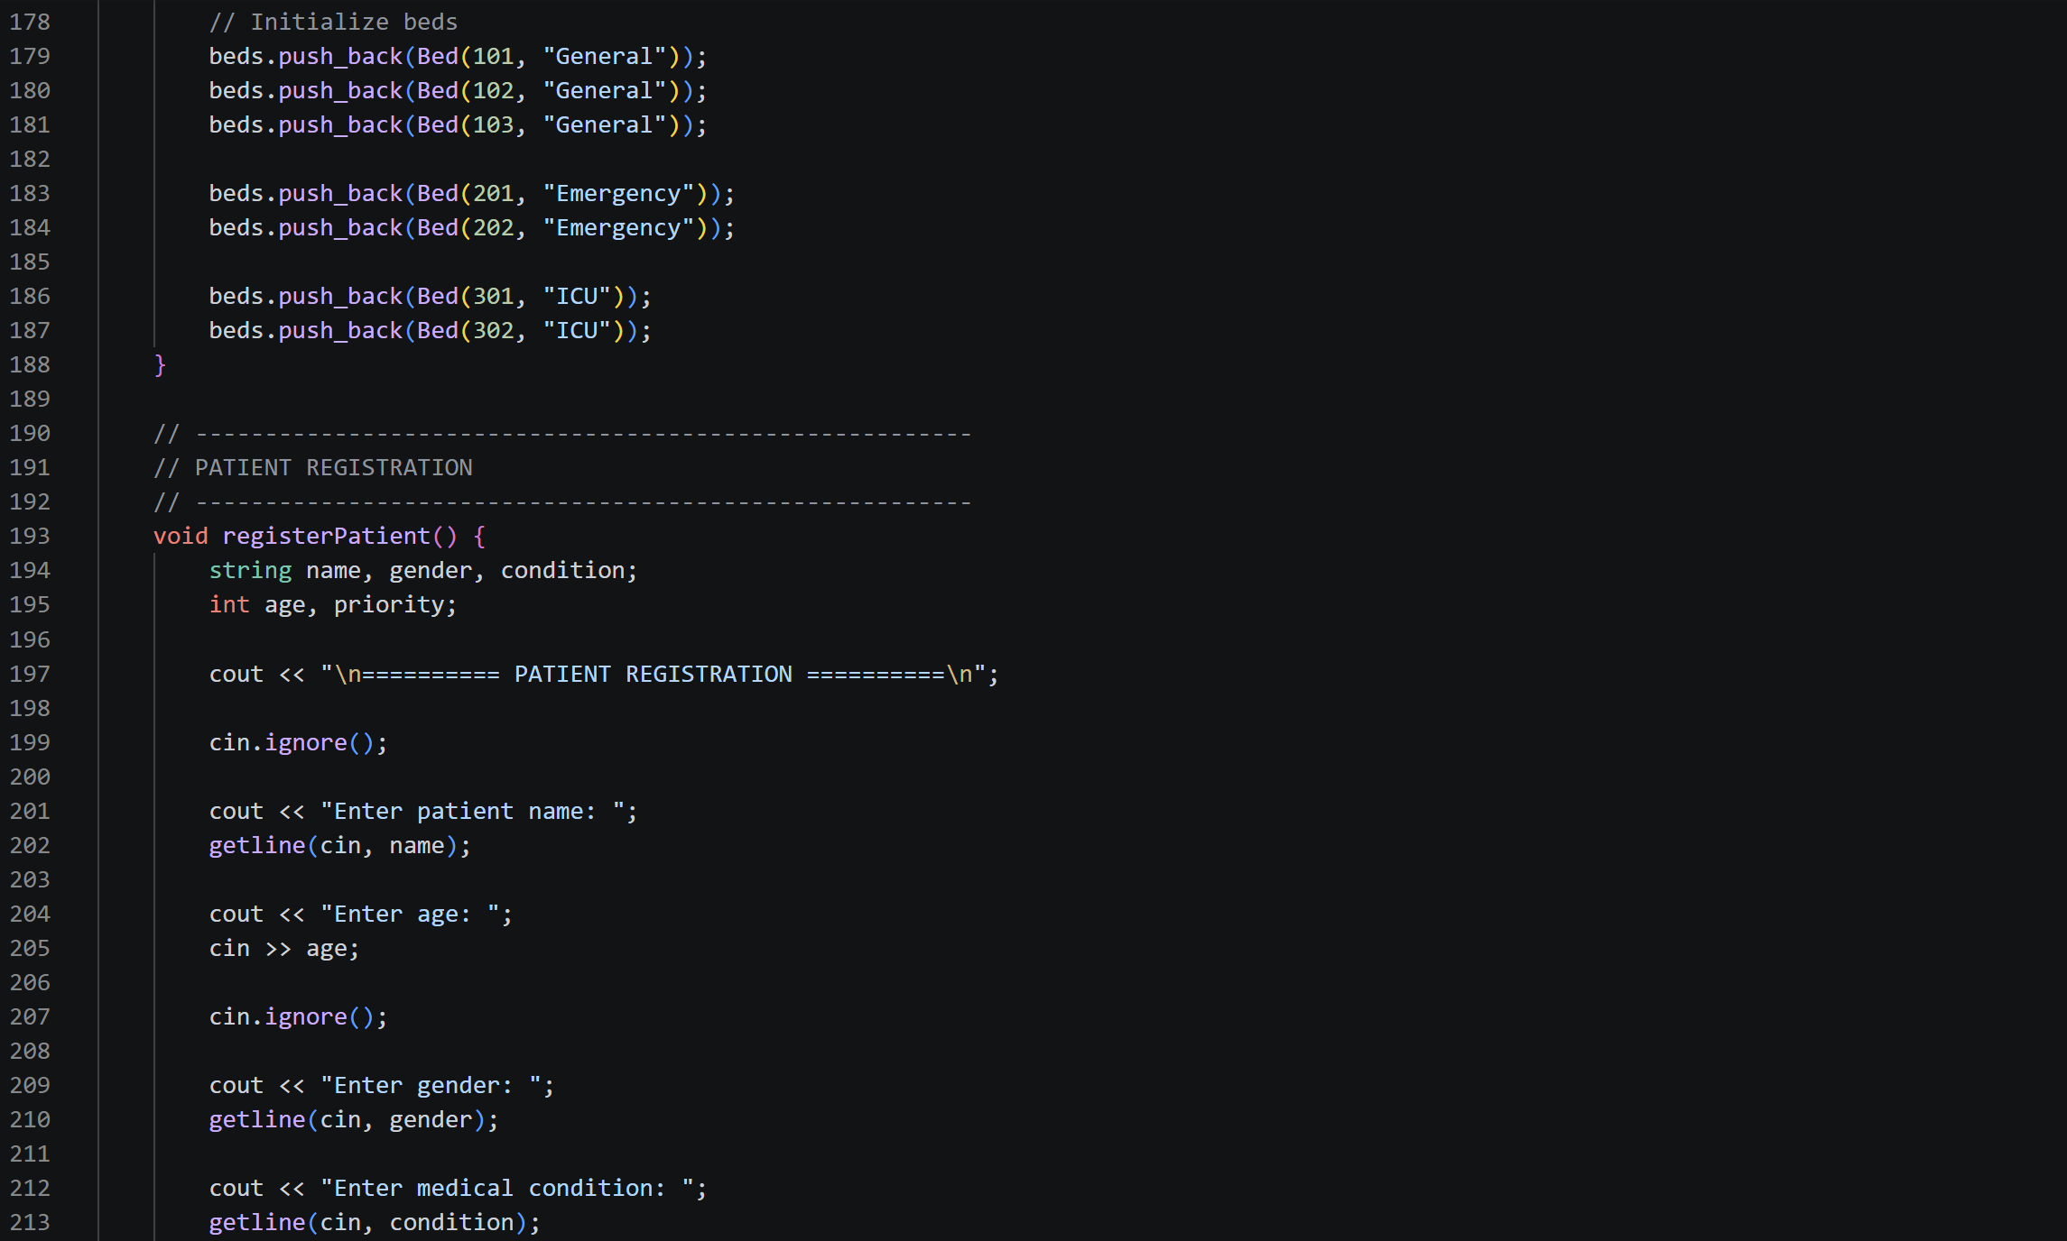

Slide 28
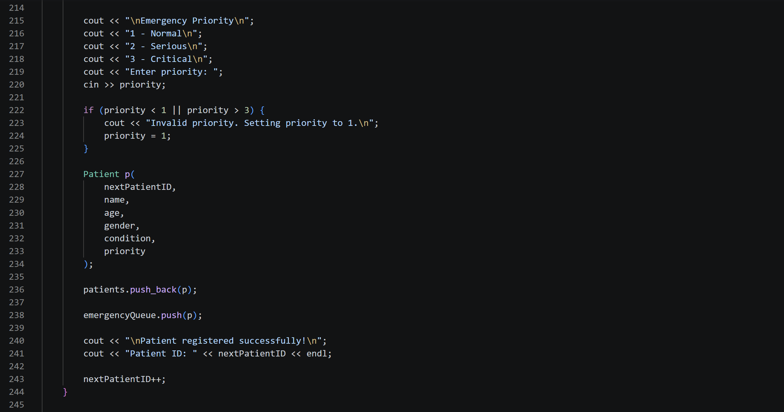

Slide 29
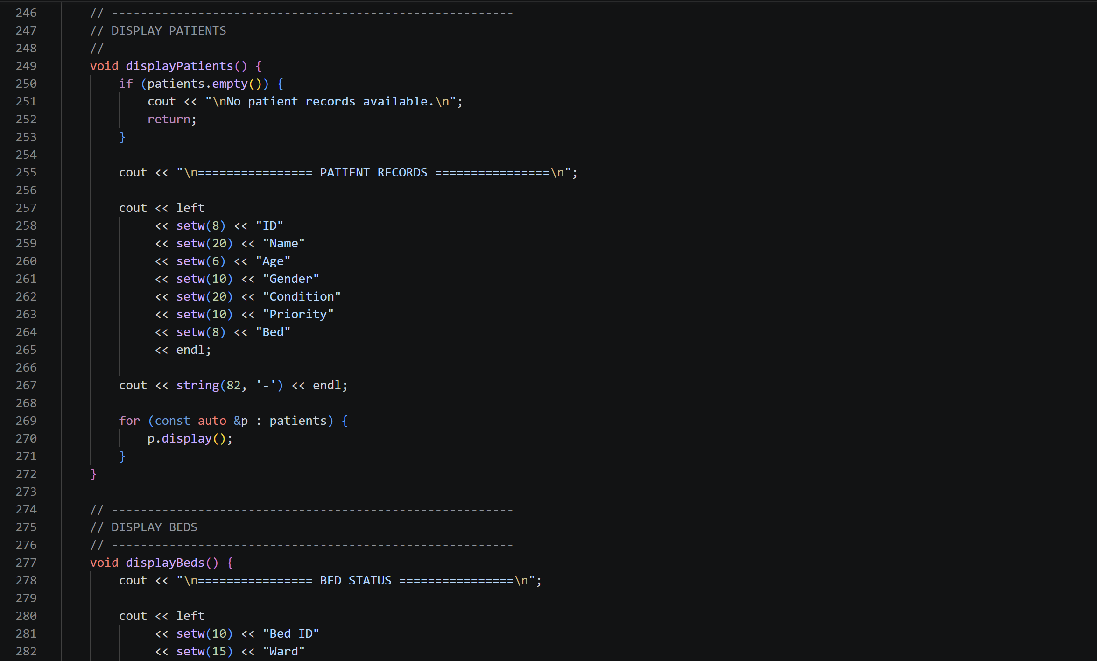

Slide 30
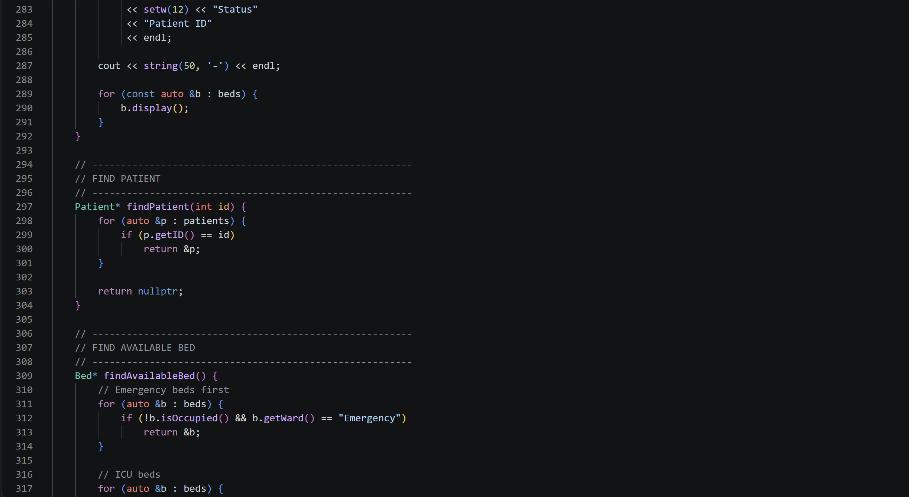

Slide 31
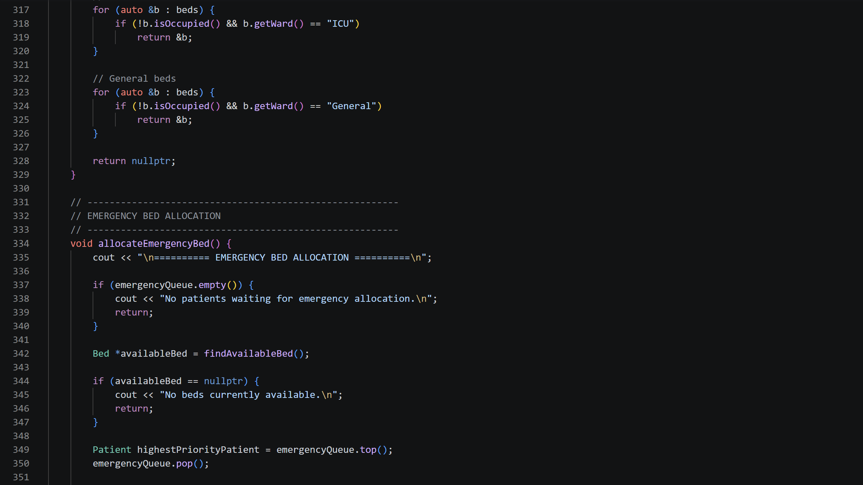

Slide 32
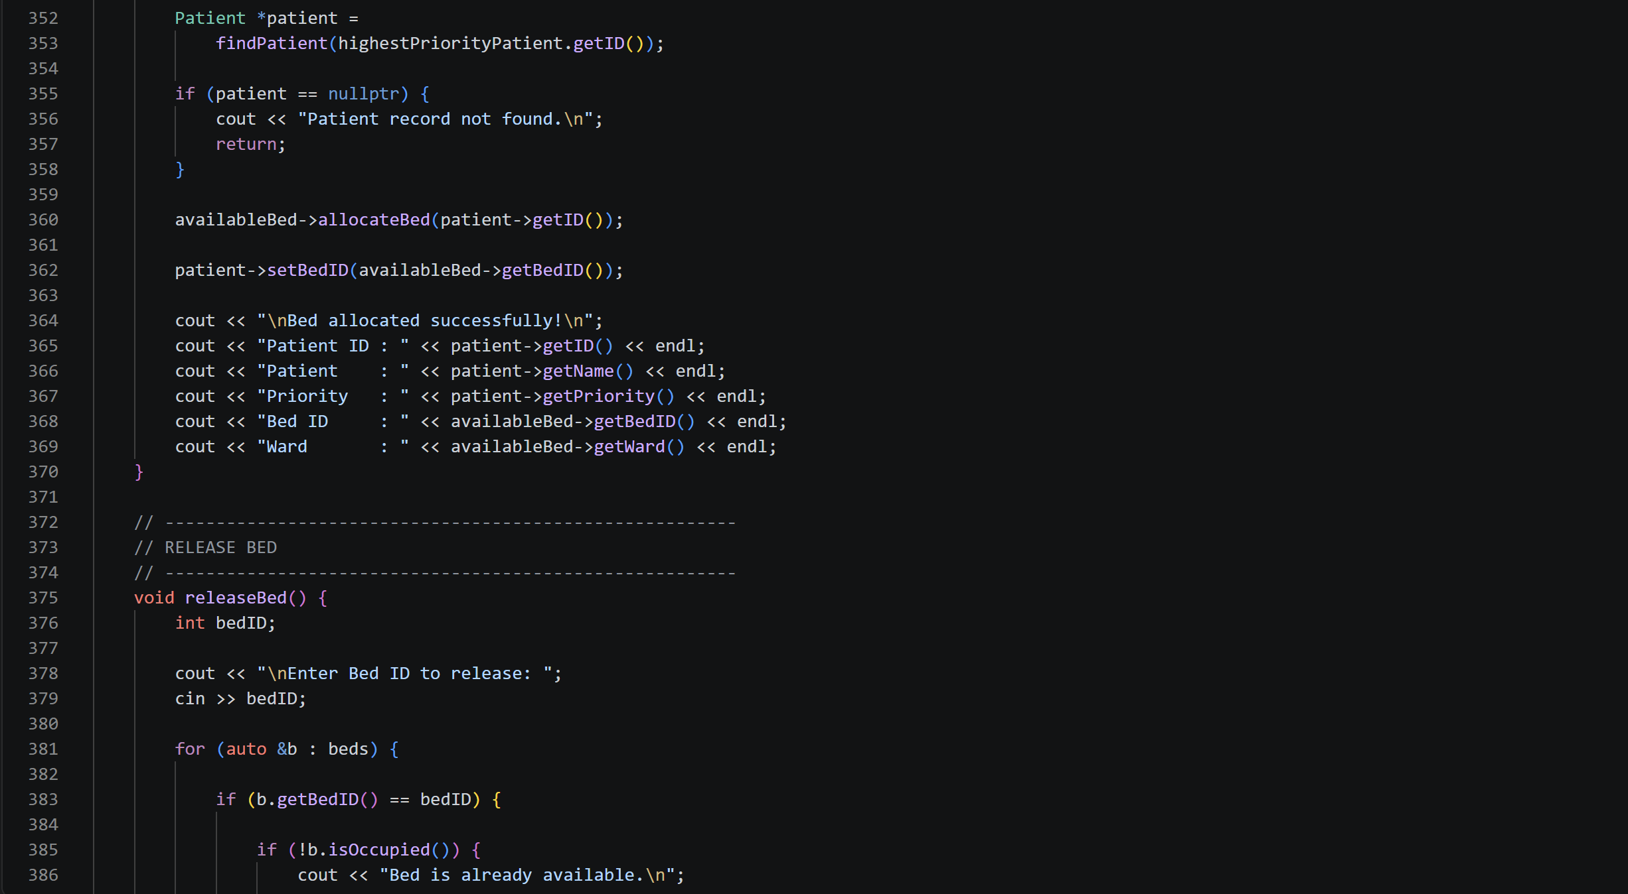

Slide 33
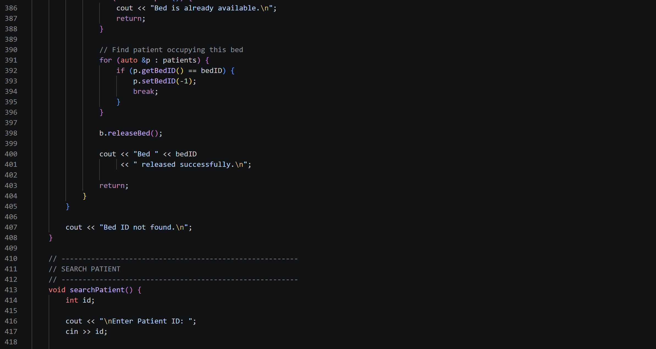

Slide 34
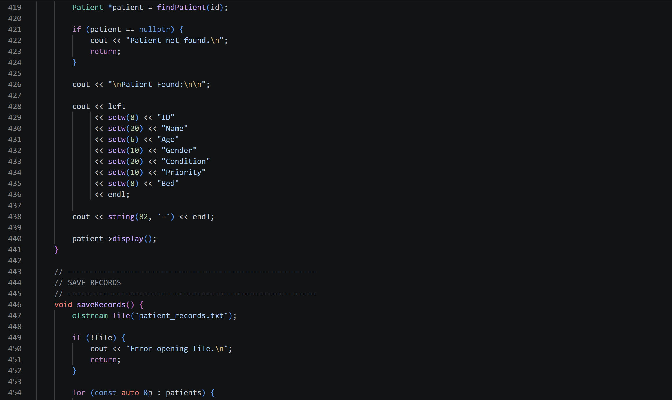

Slide 35
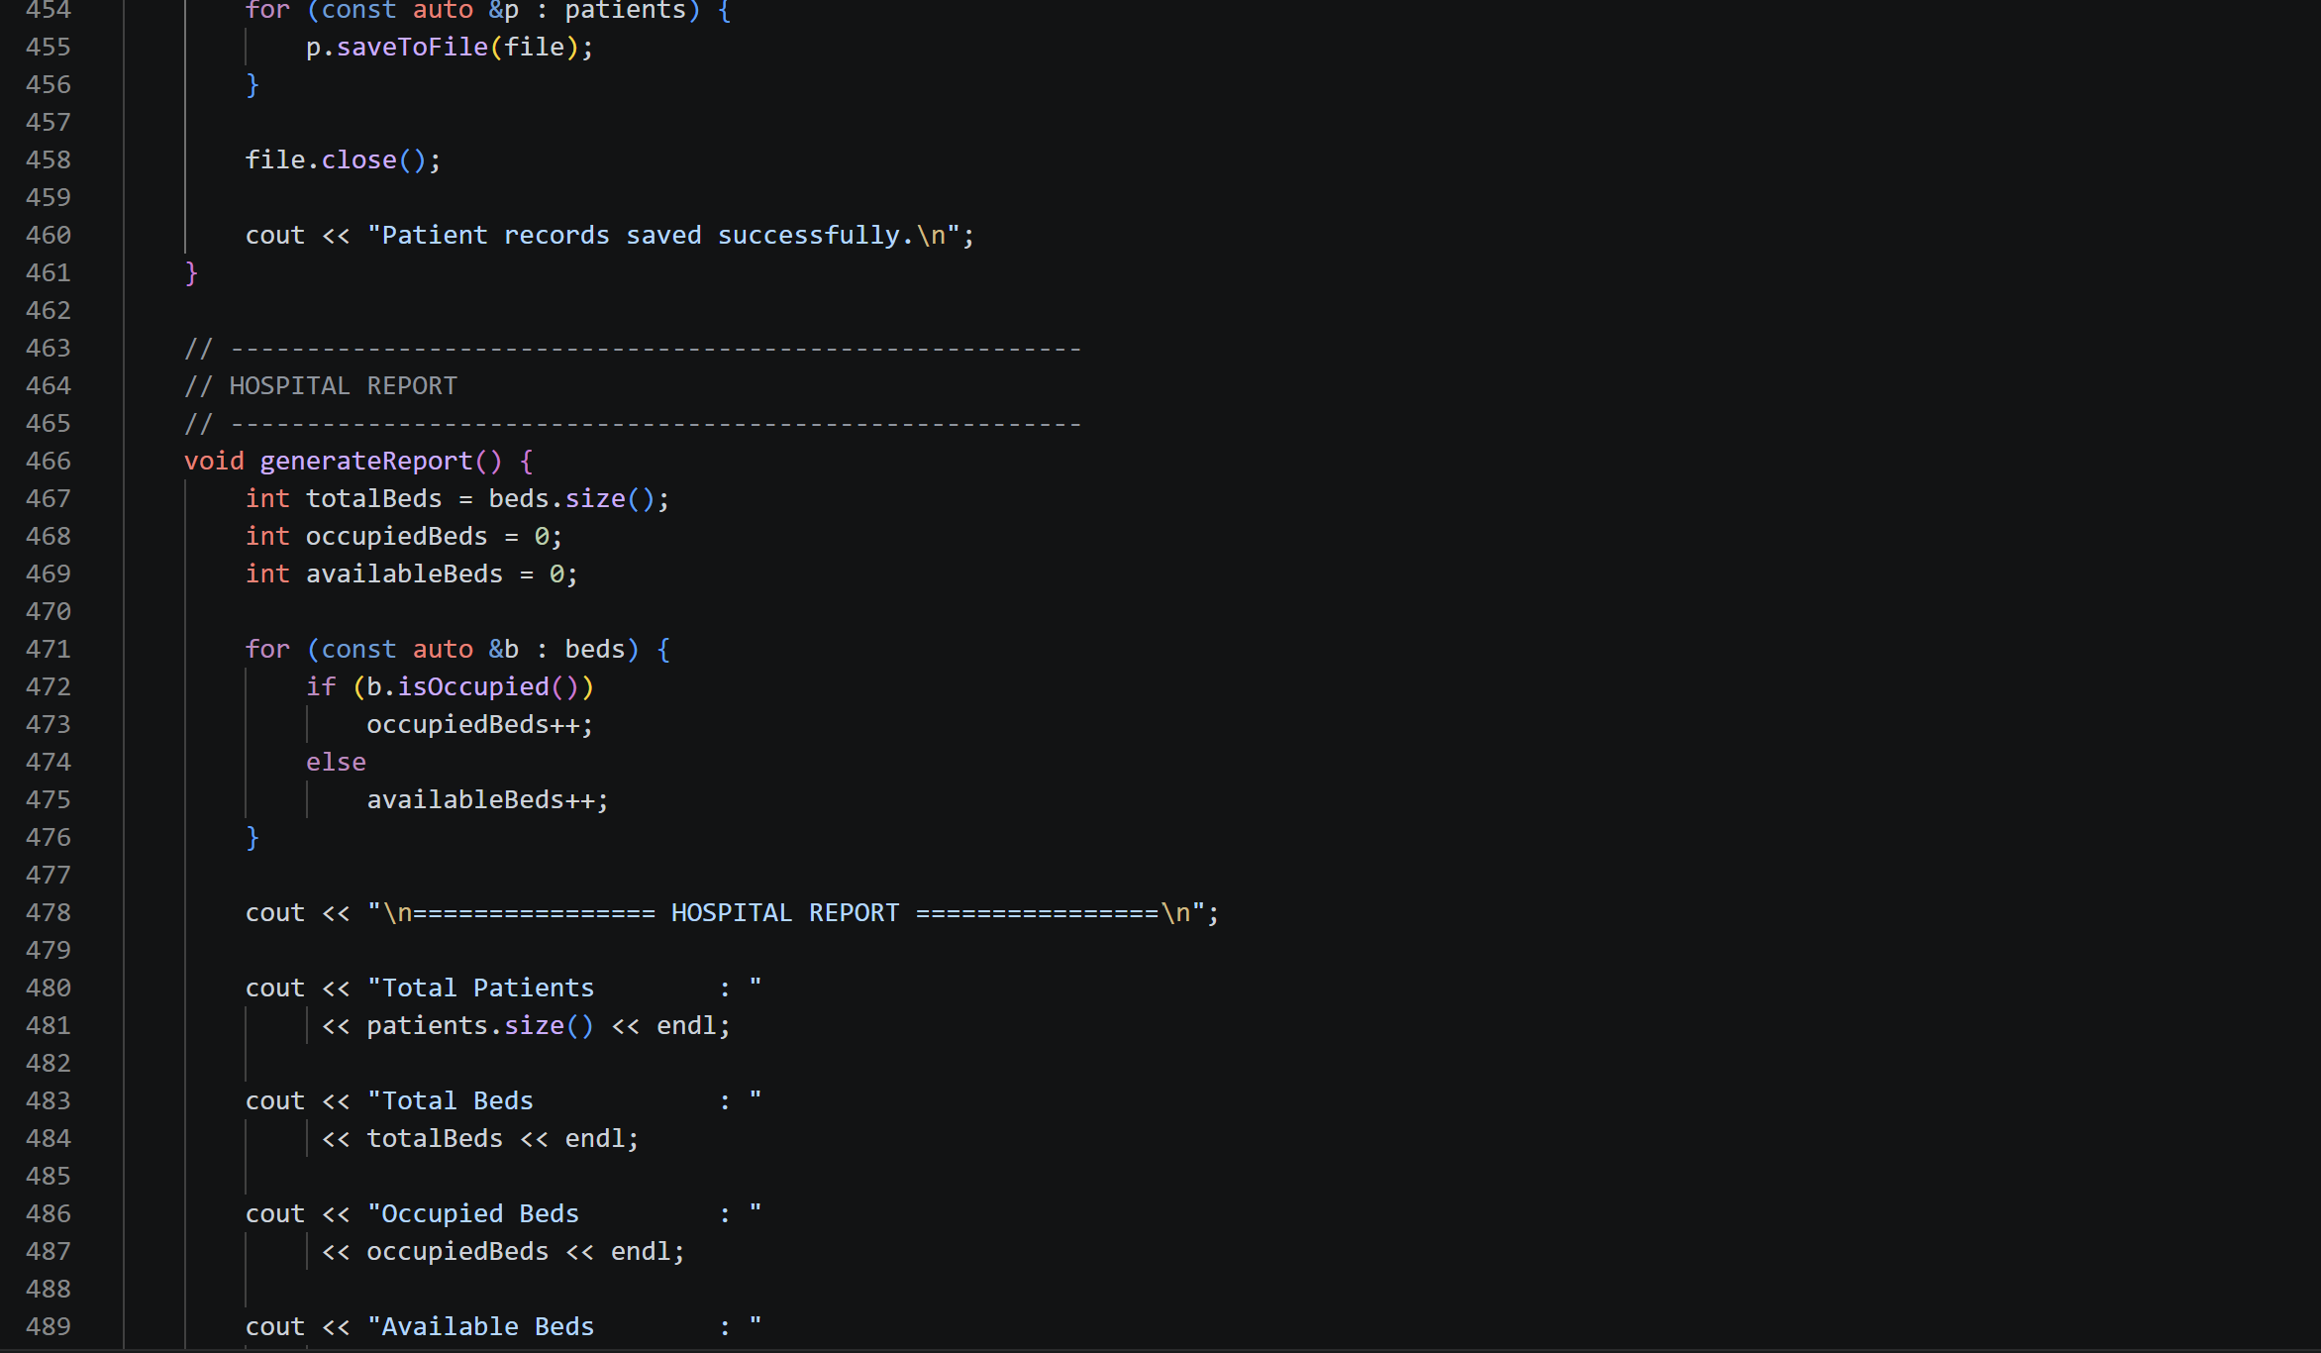

Slide 36
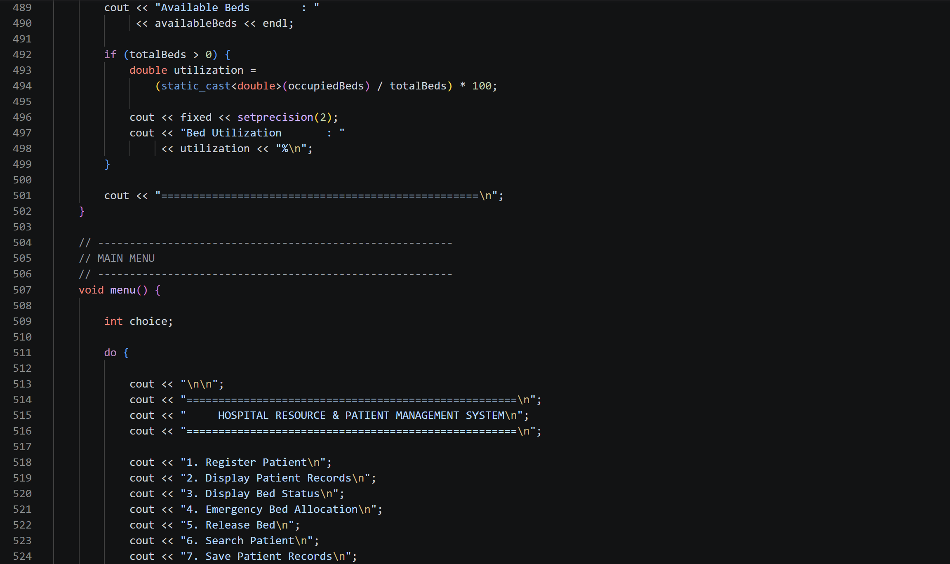

Slide 37
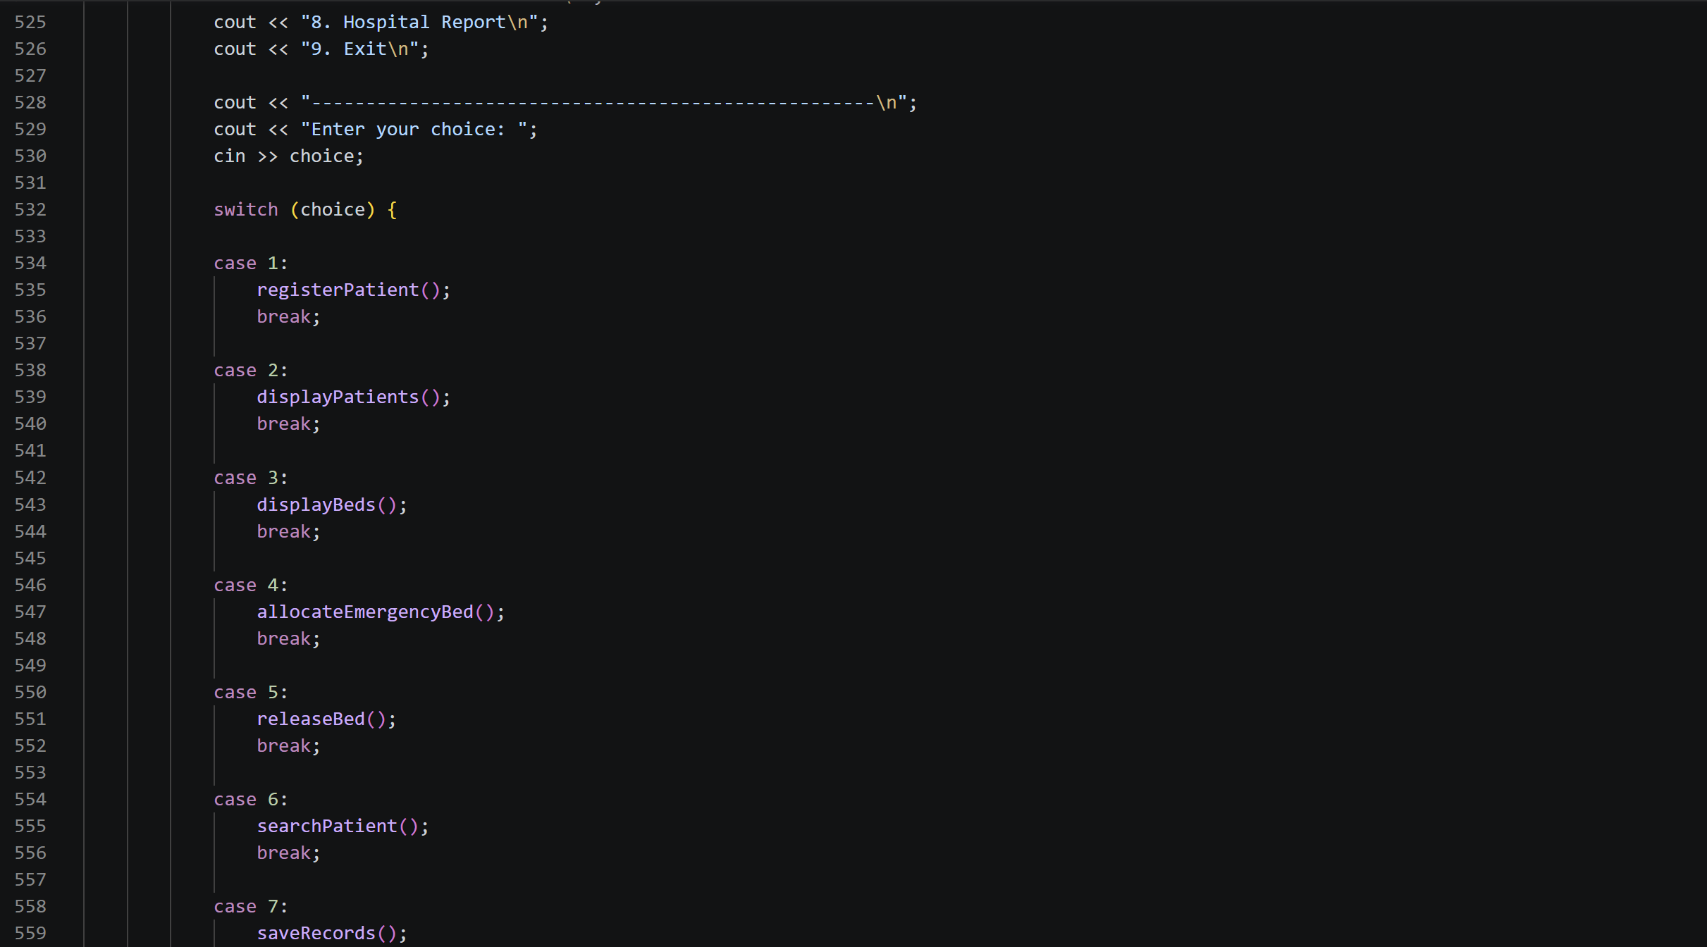

Slide 38
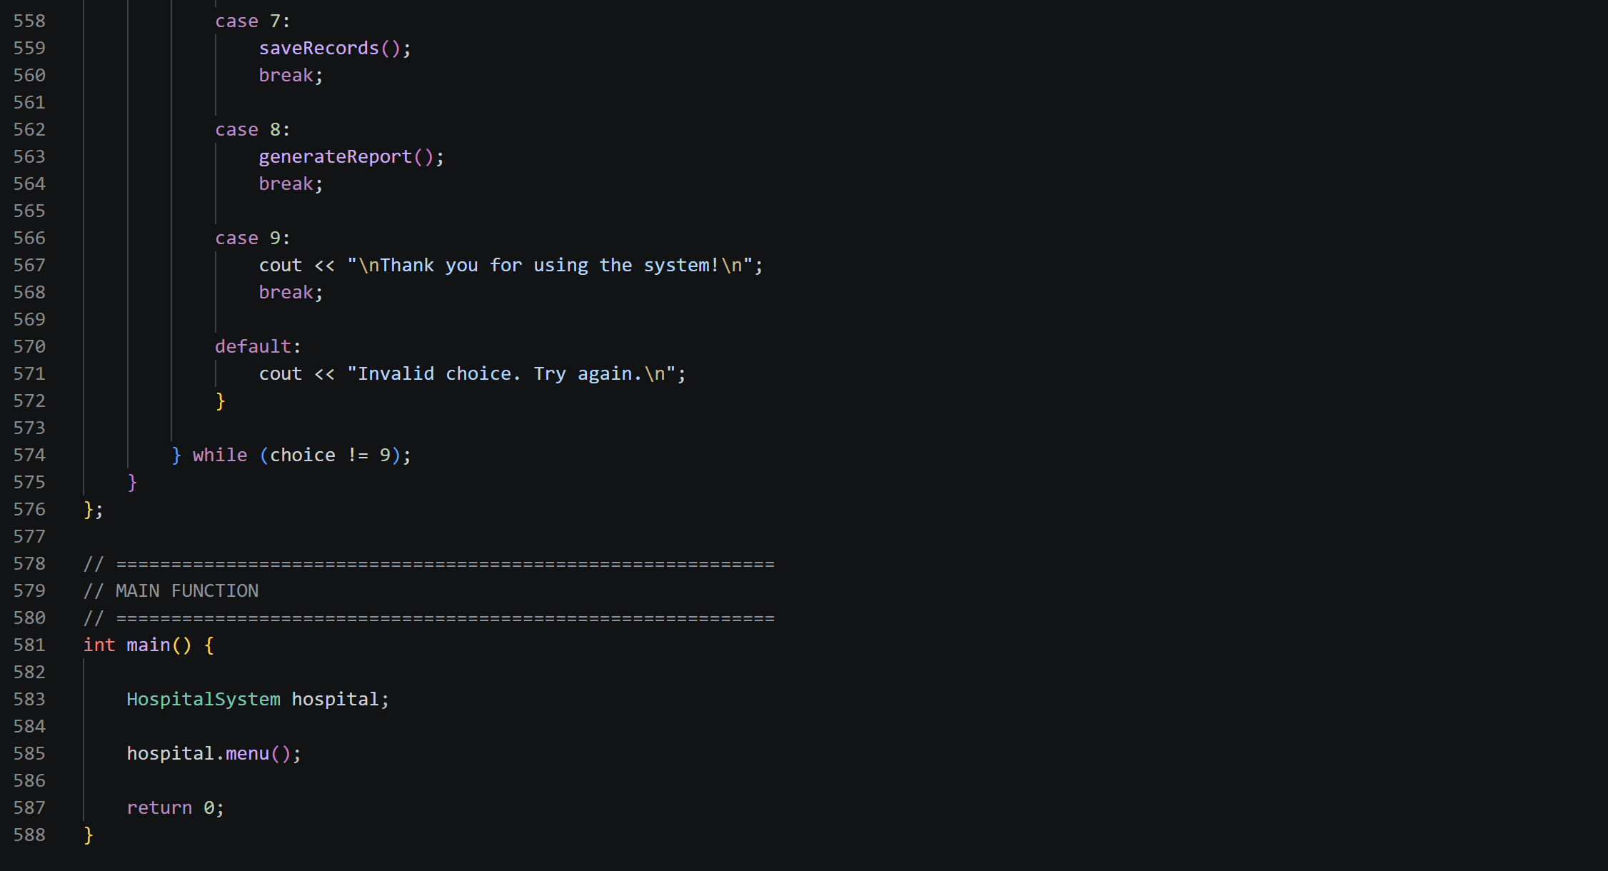

Slide 39
Thank you

